Slide 1

Use of Optimizers in Neural Network
- Kapil Panwar
17th Sep 2020

Slide 2
Content
Conventional vs AI
AI, ML and DL
Why Neural Network?
Basics of Neural Net
Libraries for Neural Network
Workstation Setup
Types of Optimizer
Let’s Begin

Slide 3


Conventional vs AI
Conventional
Step-1
AI
Step-1
Step-2
Question
Question
Model
Answer
Answer
Logic
Model
Question
Answer
Prediction

Slide 4
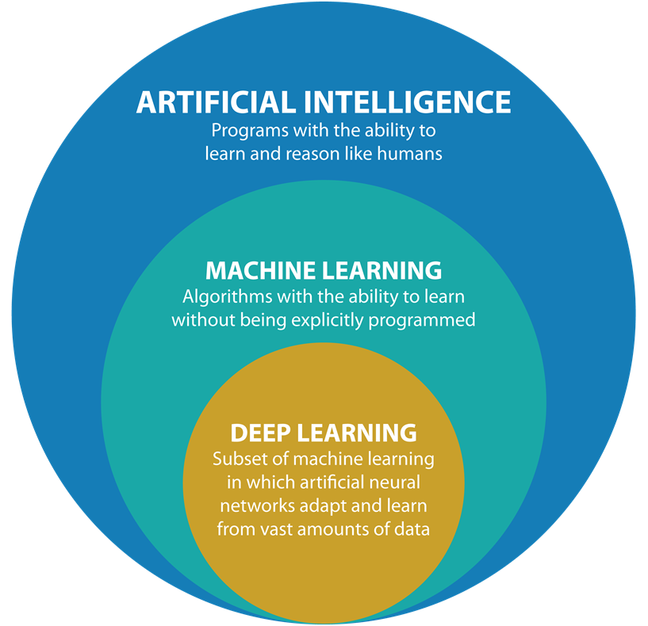
AI ML and DL

Slide 5
Why Neural Network ?
Non-Linearity
Large Data
Efficiency
More Control

Slide 6

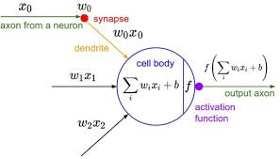
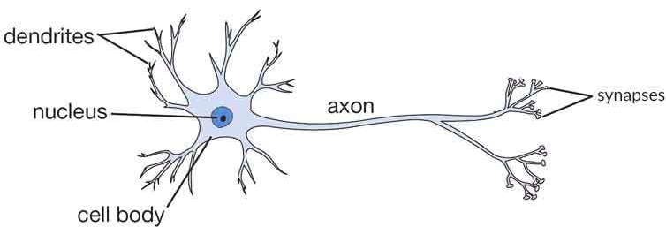
Basics of Neural Network

Slide 7
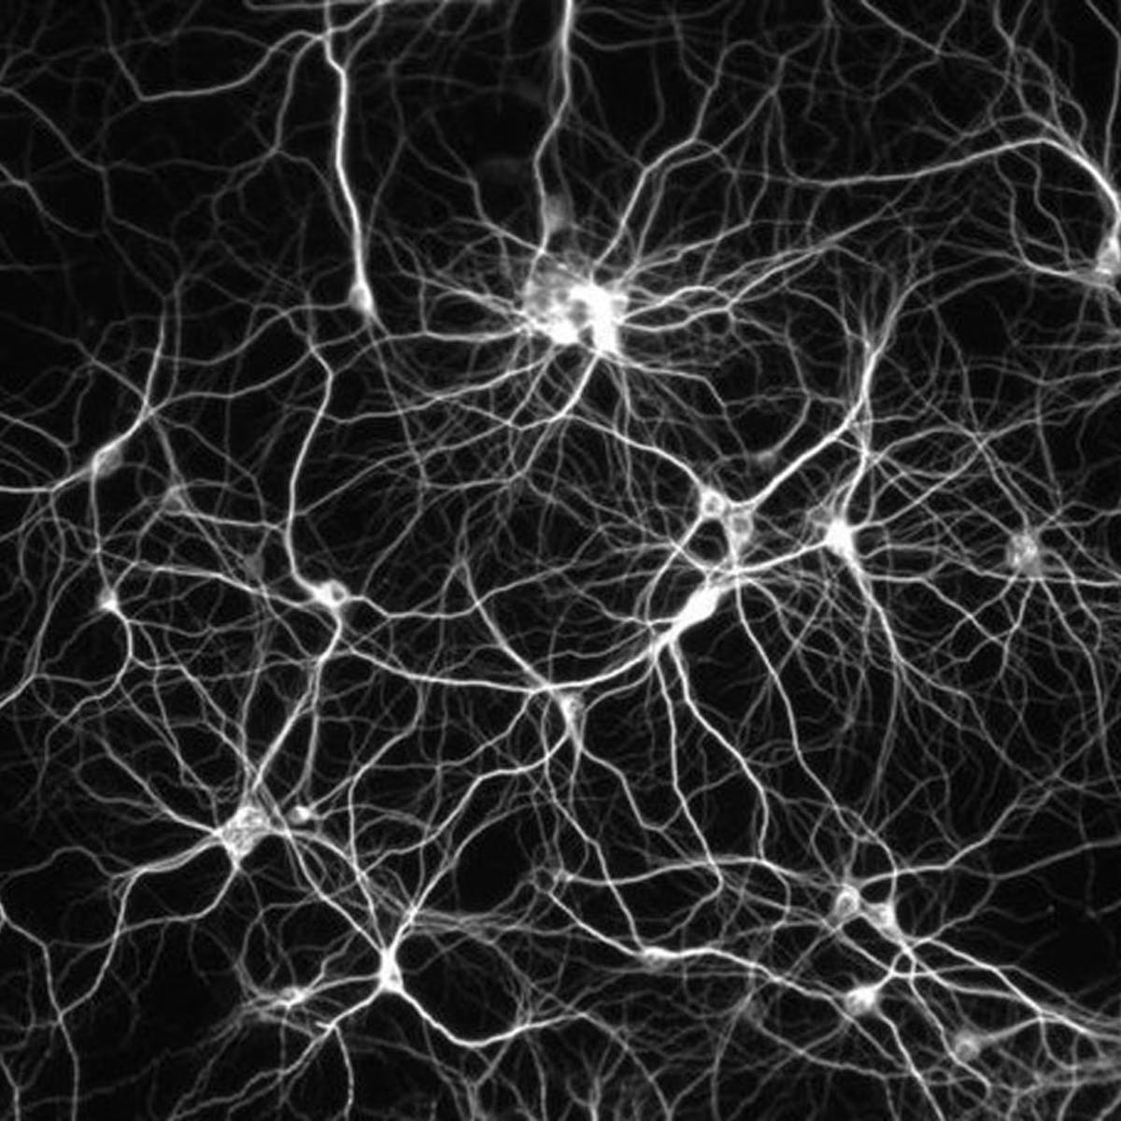
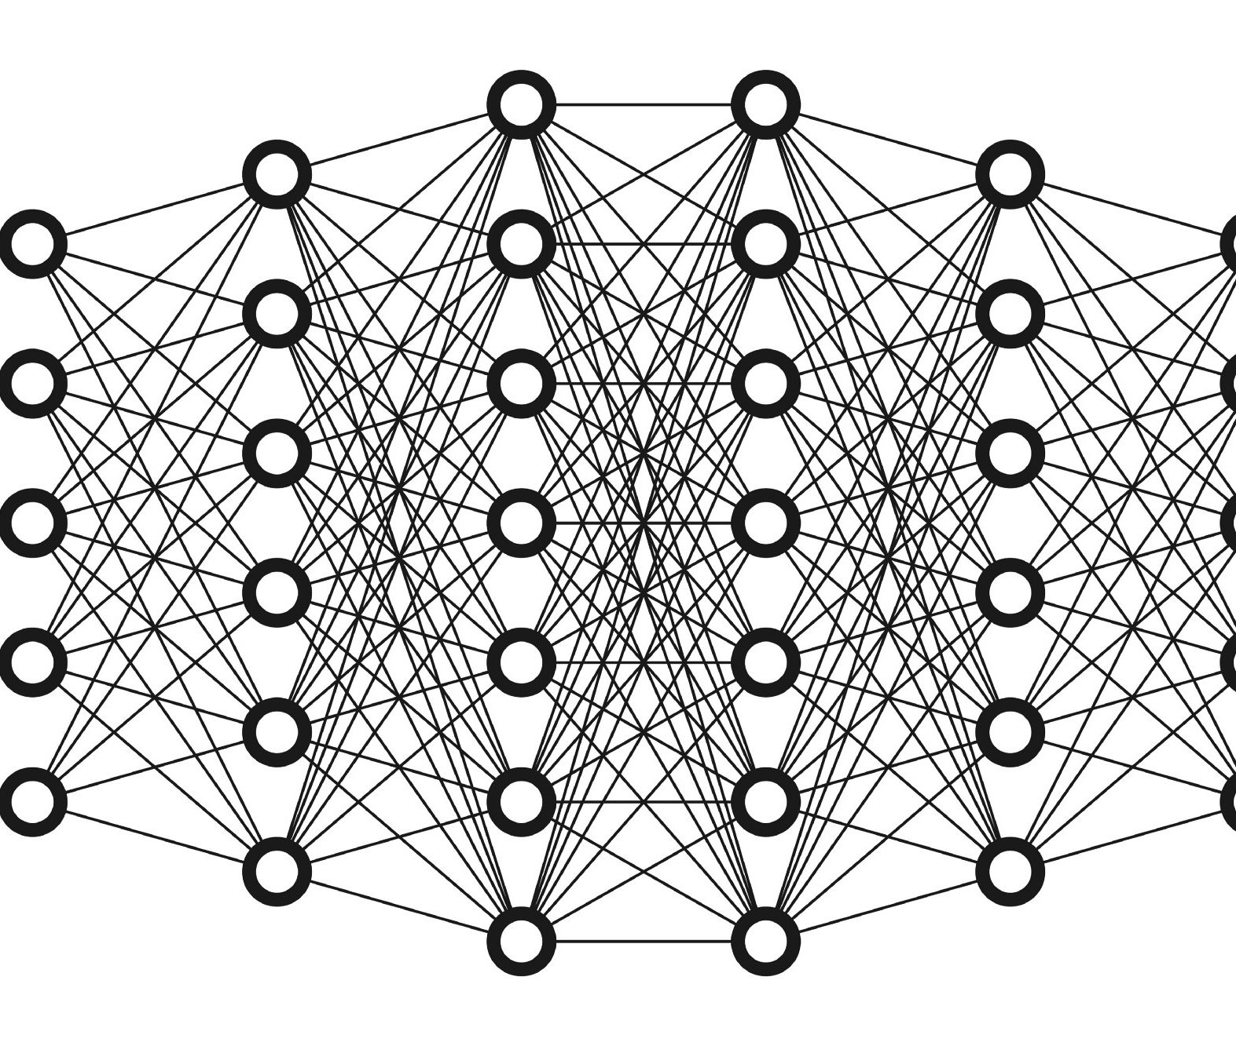
Complex Artificial Neural Network

Slide 8
Simple Steps for building a NN Model
Import Data
Transform Data
Construct Tensor
Build Model
Evaluate
Improve

Slide 9

What is Optimizer?
Part of Hyper tuning
Technique to achieve minimum loss.
Depends upon use case.

Slide 10
Type of Optimizer
Class
Class SGD: Gradient descent (with momentum) optimizer.
Class
Class Adam: Optimizer that implements the Adam algorithm.
Class
Class Adamax: Optimizer that implements the Adamax algorithm.
Class
Class Adadelta: Optimizer that implements the Adadelta algorithm.
Class
Class Adagrad: Optimizer that implements the Adagrad algorithm.
Class
Class RMSprop: Optimizer that implements the RMSprop algorithm.
Class
Class Ftrl: Optimizer that implements the FTRL algorithm.
Class
Class Nadam: Optimizer that implements the NAdam algorithm.

Slide 11

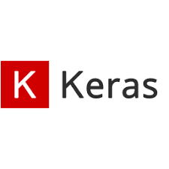








Libraries for Deep Learning

Slide 12

Workstation Setup
Visit : https://bit.ly/33zYWKb. (ai-ml-with-kapil/Optimizer_in_Neural_Network)

Slide 13




Thank You….
Any Question ?

